Slide 1
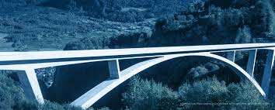
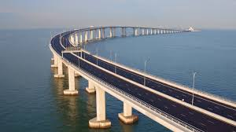
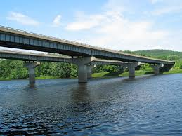
LAKSHMI NARAIN COLLEGE OF TECHNOLOGY, BHOPAL
Unit –III
Bridge Site Investigation and Planning
Transportation Engineering -I (CE-404). CE DEPT. PROF. VIJAY KUMAR MESHRAM

Slide 2
LAKSHMI NARAIN COLLEGE OF TECHNOLOGY, BHOPAL
Transportation Engineering -I (CE-404). CE DEPT. PROF. VIJAY KUMAR MESHRAM

Slide 3
LAKSHMI NARAIN COLLEGE OF TECHNOLOGY, BHOPAL
Transportation Engineering -I (CE-404). CE DEPT. PROF. VIJAY KUMAR MESHRAM

Slide 4
LAKSHMI NARAIN COLLEGE OF TECHNOLOGY, BHOPAL
Transportation Engineering -I (CE-404). CE DEPT. PROF. VIJAY KUMAR MESHRAM

Slide 5
LAKSHMI NARAIN COLLEGE OF TECHNOLOGY, BHOPAL
Transportation Engineering -I (CE-404). CE DEPT. PROF. VIJAY KUMAR MESHRAM

Slide 6
LAKSHMI NARAIN COLLEGE OF TECHNOLOGY, BHOPAL
Transportation Engineering -I (CE-404). CE DEPT. PROF. VIJAY KUMAR MESHRAM

Slide 7
LAKSHMI NARAIN COLLEGE OF TECHNOLOGY, BHOPAL
Transportation Engineering -I (CE-404). CE DEPT. PROF. VIJAY KUMAR MESHRAM

Slide 8
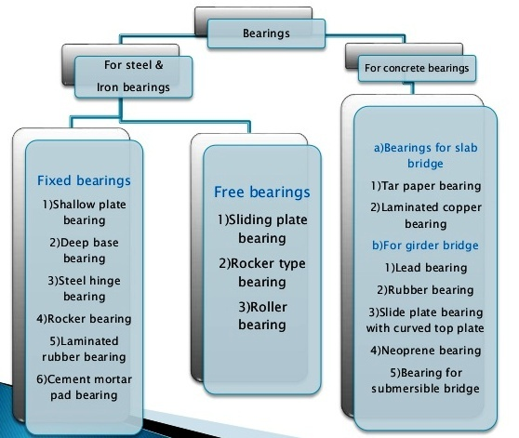
LAKSHMI NARAIN COLLEGE OF TECHNOLOGY, BHOPAL
Transportation Engineering -I (CE-404). CE DEPT. PROF. VIJAY KUMAR MESHRAM

Slide 9
LAKSHMI NARAIN COLLEGE OF TECHNOLOGY, BHOPAL
Transportation Engineering -I (CE-404). CE DEPT. PROF. VIJAY KUMAR MESHRAM

Slide 10
LAKSHMI NARAIN COLLEGE OF TECHNOLOGY, BHOPAL
Transportation Engineering -I (CE-404). CE DEPT. PROF. VIJAY KUMAR MESHRAM

Slide 11
LAKSHMI NARAIN COLLEGE OF TECHNOLOGY, BHOPAL
Transportation Engineering -I (CE-404). CE DEPT. PROF. VIJAY KUMAR MESHRAM

Slide 12
LAKSHMI NARAIN COLLEGE OF TECHNOLOGY, BHOPAL
Transportation Engineering -I (CE-404). CE DEPT. PROF. VIJAY KUMAR MESHRAM

